Slide 1
MATLAB
Class 7: Computational models
& model selection

Slide 2
What is a model?

Slide 3

What is a model?

Slide 4
What is a model? A way to describee phenomena in abstract terms that is useful for us to understand, define, quantify or predict abstract-- removed from referent

Slide 5
What is a model? “the aim of which is to make a particular part or feature of the world easier to understand, define, quantify, visualize, or simulate “ --Wikipedia

Slide 6
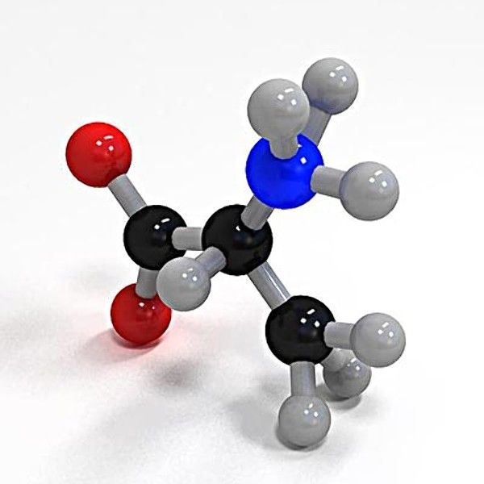
Models in Science
Descriptive Model:
Abstraction that represents reality in nonliteral terms
E.g. Bohr-Rutherford model
Computational Model:
A mathematical description of a phenomena that requires computation
Nothing special about computers… you could use toilet paper and stones (Searle, 1980)
*** not mutually exclusive

Slide 7





Why use computational models
If you wanted to build a machine, you would need to know how that machine takes its inputs and processes information to produce output
This is a mechanistic understanding

Slide 8
Why use computational models
With mechanistic explanations of processes, you can understand in a general sense what would happen if you gave the machine input A, B, or C
Similarly, you would know how to fix it if it isn’t working

Slide 9
Why use computational models
When studying the brain, we can try to understand how it works at different levels :
Knowing the gist of what a machine is doing/ purpose
Knowing the operations and procedures of the machine
Knowing how the machine implements said procedures

Slide 10
Why use computational models
In the case of a calculator for example:
We know that it adds numbers together
It does so through binary codes, circuits, and wires
It does this by passing electrical current and opening/closing transistors

Slide 11
Marr’s Three levels of analysis
Computational
What is the goal of the computation, why is it appropriate, and what strategy is used to carry it out?
Representational / Algorithmic
How can this computational theory be implemented? What is the representation of the inputs and outputs, and what is the algorithm for the transformation?
Hardware Implementation
How can the representation and algorithm be realized physically?
Notes:
Marr, D. C. (1982). A computational investigation into the human representation and processing of visual information. Free-man, San Francisco, CA.

Slide 12
Steps to making a Computational Model
Step 1: Reformulate the problem in terms of a rigorous mathematical equation
Step 2: Make any additional assumptions necessary not included in the conceptual framework (ad hoc assumptions)
Step 3: Estimate values for the model parameters
Step 4: Compare the predictions of your model to competing models. Which one produces results closets to the empirical data?
Step 5: Reformulate framework and start all over again!

Slide 13
Model fitting algorithms
All model fitting algorithms work by trying to find the global minima / maxima of your parameter space
If you think of all possible values of your model parameters plotted against error, fitting a model essentially tries to find the minima in this space

Slide 14
Model fitting algorithms
There are many different algorithms used all with their advantages and disadvantages
One example is Least-squares which tried to minimize the sum of squared residuals (see class 8)
This goes beyond the scope of this class

Slide 15
Curve Fitting
One way you can fit a model to your data is by attempting to fit polynomial curves to it with fit()
This function takes in your x and y data as well as the desired poly function you wish to fit

Slide 16
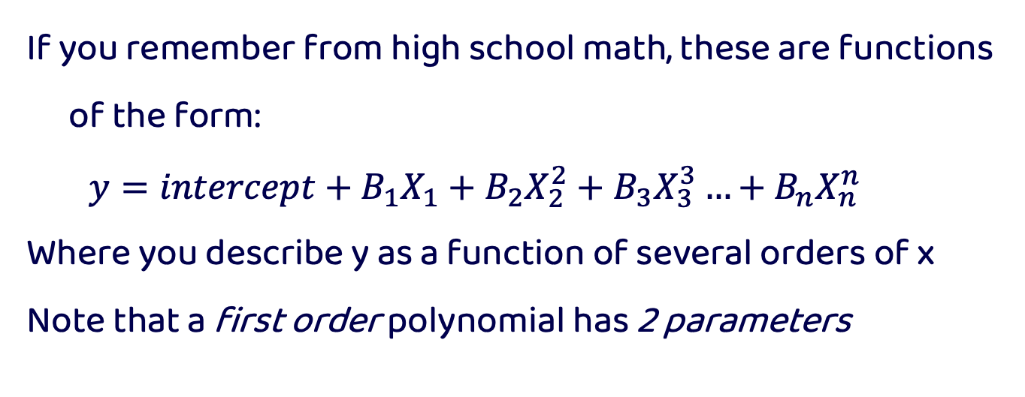
Polynomial Functions
If you remember from high school math, these are functions of the form:
$$y=intercept+B_{1}X_{1}+B_{2}X_{2}^{2}+B_{3}X_{3}^{3}…+B_{n}X_{n}^{n}$$
Where you describe y as a function of several orders of x
Note that a first order polynomial has 2 parameters

Slide 17
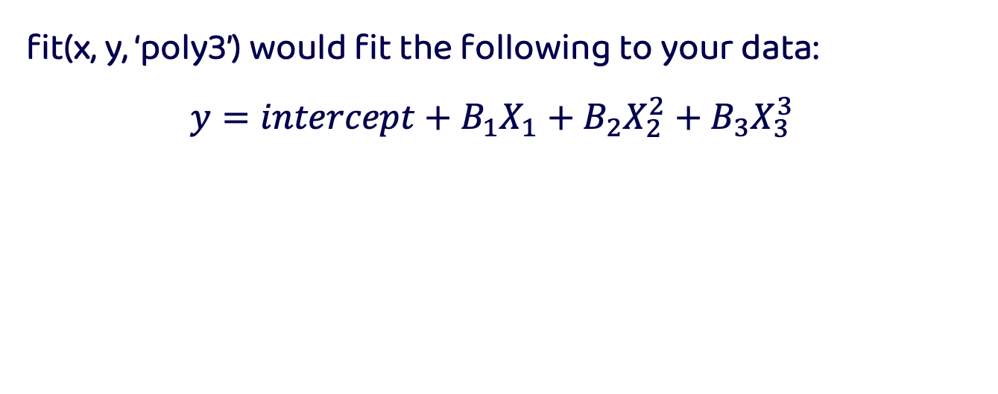
Polynomial Functions
fit(x, y, ‘poly3’) would fit the following to your data:
$$y=intercept+B_{1}X_{1}+B_{2}X_{2}^{2}+B_{3}X_{3}^{3}$$

Slide 18
Model Error
Making predictions comes with some form of error, models are never perfect just like humans aren’t (f.t. Hannah Montana)
But there are many methods to compute how wrong your predictions are from your data

Slide 19
Model Error
It is important to note, however, that when you want to assess how good your model is predicting something you need to use data that your model has not seen (i.e., not been trained on)
This is done to avoid OVERFITTING

Slide 20
Error
Squared Error
Error
Root MSE
Square the difference between observed and predicted
Observed minus predicted
Square root of mean square error

Slide 21
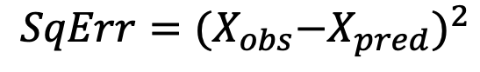
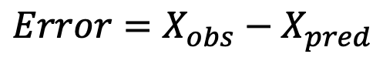
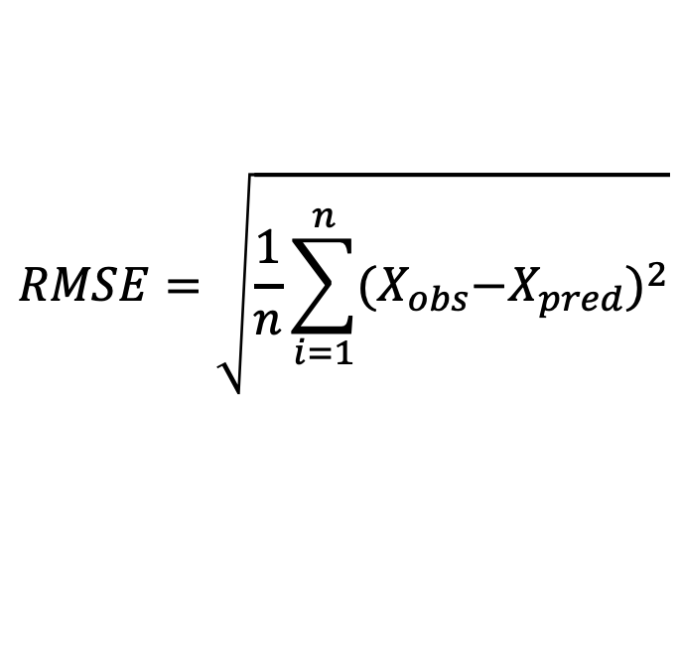
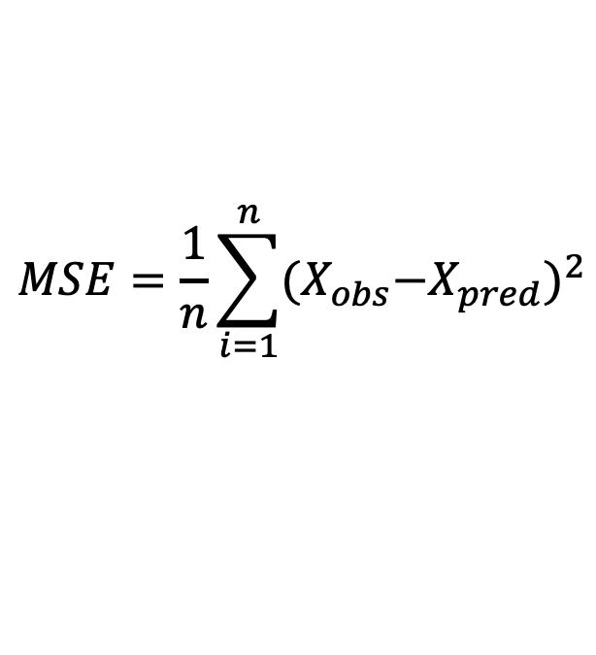
Error Formulas
$$MSE=\frac{1}{n}\sum_{i=1}^{n}{{{(X}_{obs}−X_{pred})}^{2}}$$
$$Error=X_{obs}−X_{pred}$$
$$RMSE=\sqrt{\frac{1}{n}\sum_{i=1}^{n}{{{(X}_{obs}−X_{pred})}^{2}}}$$
$$SqErr={{(X}_{obs}−X_{pred})}^{2}$$

Slide 22
Picking the best models based on error
Generally speaking, the best fitting model is the one that predicts the data the best → this ultimately entails minimizing error (regardless of which kind of error you are measuring)
It is important to note that you want a model that minimizes error within your sample and across all other possible samples (i.e., generalizes)
But there are other considerations beyond minimizing error

Slide 23
Picking the best model based on observations
Instead of picking the best model by minimizing error, you can alternatively pick the best model by trying to maximize the likelihood
Said another way, picking a model that maximally produces data like yours

Slide 24
Likelihood is NOT probability
In stats probability represents possibilities that are exhaustive and mutually exclusive (e.g. a coin toss), they always add up to 1
Likelihoods do not need to be exhaustive or exclusive

Slide 25
What is likelihood
Looking at a probability density function we can understand the differences between probability and likelihood
Probability is the area under the curve up to a value xi
Likelihood is the value of the function at xi

Slide 26
What is likelihood

Slide 27
Likelihood Example
Let us assume we are a data scientists at Vogue and want to find out which musician is the most likely to have sung the latest hit song

Slide 28
Likelihood Example
We know the quality of the song and the PDF of different artists’ song quality
J Lo
Mariah Carey

Slide 29
Likelihood Example
We know the quality of the song and the PDF of different artists’ song quality
J Lo
Mariah Carey

Slide 30
Likelihood Example
Given the song quality what parameter (i.e., artist) is likely to generate the data (i.e., song) ?
J Lo
Mariah Carey

Slide 31
Likelihood Example
This is a problem of maximizing the likelihood of a parameter given data
J Lo
Mariah Carey

Slide 32
Likelihood Example

Slide 33
Likelihood
Therefore, we can see how maximizing the likelihood can generate a model that best explains the distribution of our data based on an unknown parameter (random variable)

Slide 34
Likelihood
The goodness-of-fit of models will be described in Log likelihoods. These values by themselves are meaningless. They can only tell you how well a model fits RELATIVE to another model fit on the SAME data.

Slide 35
Adding more variables
Each model has a different number of ‘free’ variables / values that can vary
The more your model is free to vary, the better it can fit data
Visually, this is the equivalent of adding more bends to your data
While we love flexibility, models that are too flexible are hard to interpret and tend not to generalize well

Slide 36
Degrees of freedom

Slide 37
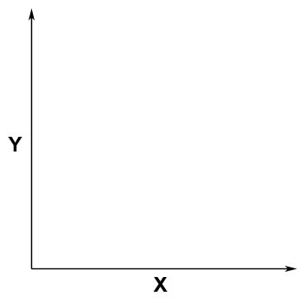
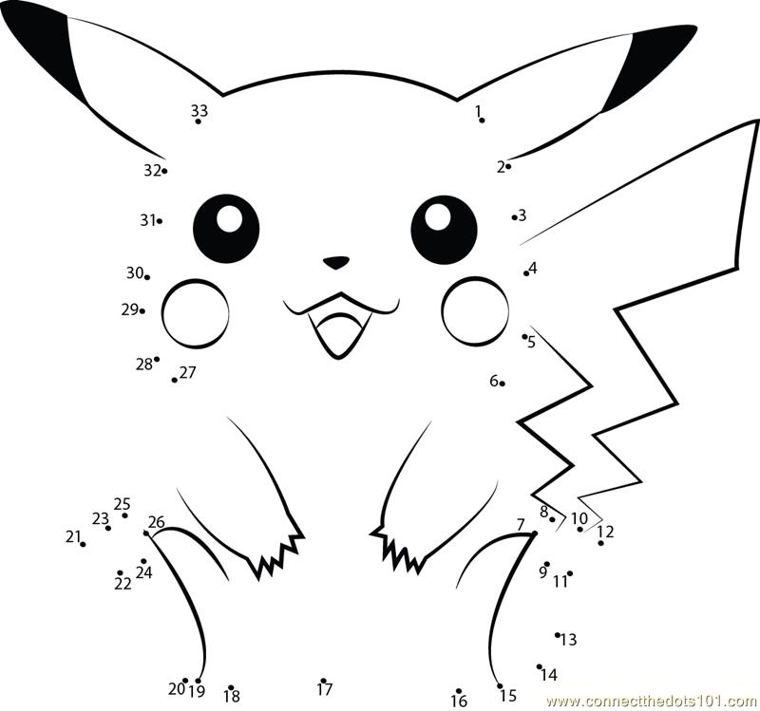
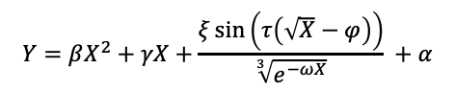
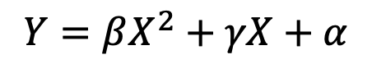
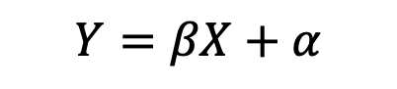
Overfitting
$$Y=βX+α$$
$$Y=βX^{2}+γX+α$$
$$Y=βX^{2}+γX+\frac{ξ\sin\left(τ\left(\sqrt{X}−φ\right)\right)}{\sqrt[3]{e^{−ωX}}} +α$$

Slide 38

Occam’s Razor
“Plurality should not be posited without necessity.”
Heuristic for the development of scientific models
Parsimonious
Falsifiable
Related to Overfitting

Slide 39
Model selection
We can try and quantify a measure that balances both the fit of the model as well as parsimony (i.e., the number of parameters)
Akaike information criterion (AIC).
−2logL(θ) + 2k
Bayesian information criterion (BIC)
−2logL(θ) + k*log(T)
Where k is the number of parameters fit to T observations

Slide 40
What is a regression ?

Slide 41
To put it simply a regression is a set of statistical tools used to describe and quantify the relationship between dependent and independent variables

Slide 42
Dependent variables (y) are the outcomes we wish to predict based on independent variables

Slide 43
Independent variables (x) are the covariates/ predictors / features we think change the value of the outcome variable in a quantifiable way

Slide 44
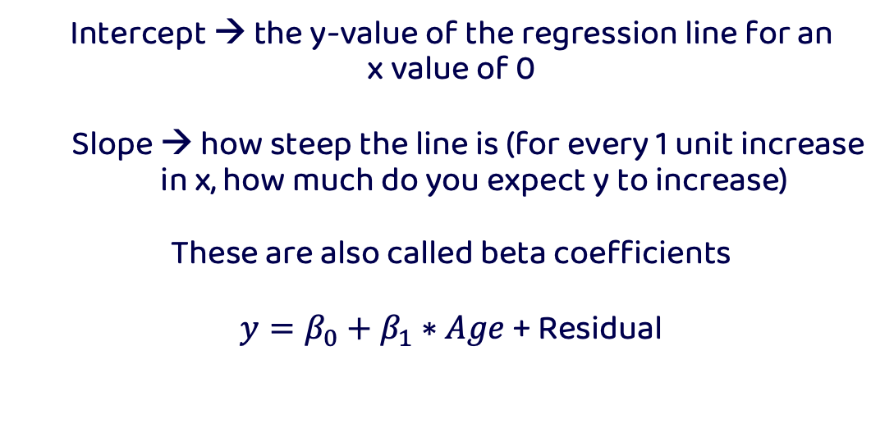
Linear regression models
Intercept → the y-value of the regression line for an
x value of 0
Slope → how steep the line is (for every 1 unit increase in x, how much do you expect y to increase)
These are also called beta coefficients
$y=β_{0}+β_{1}∗Age$ + Residual

Slide 45
Linear Regression Models

Slide 46
Statistical twins
ANOVAs and Linear regressions are not so different from one another… they are a LOT alike! In fact ANOVAs are a special case of a regression where all variables are categorical
Let us explore how they are two sides of the same coin:

Slide 47
Statistical twins
If you run a one-way ANOVA and a regression, you will notice that the ‘cell’ means or group means are in fact the same as the coefficients (i.e., effects) of a regression when you consider the intercept. See code for example
*** Note that the way you code your data will affect how you interpret the results! See next class for details.

